Slide 1
Laser weapon
Jasper Cairns & Nik-o-b-ware

Slide 2
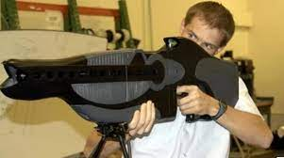
Overview
History
Plan and Implementation
Upsides/Pros
Upsides/Pros 2
Downside/Cons
Downside/Cons
Summary
References

Slide 3
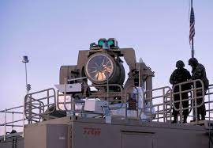
History
The first laser was developed in the 1960s.
In the late 1970s and 1980s, it was a busy time period for developing lasers into possible weapon systems.
As of 2023, directed-energy weapons, including lasers, remain at the experimental stage.
Most laser guns are not used and made anymore due to cost.
Raytheon founded the laser weapon industry

Slide 4

Plan and Implementation
Militaristic applications
Cutting and welding
Laser tag

Slide 5
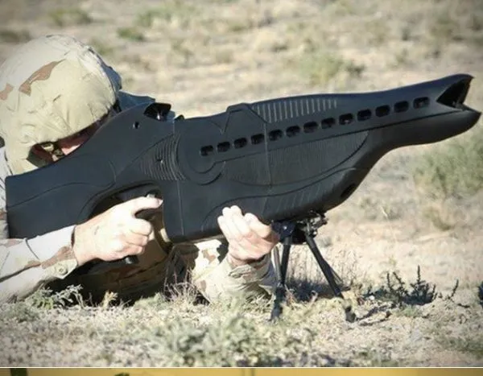
Upsides/Pros
They would help in the military
They are more precise
Unlimited ammo
They would be safer than traditional guns

Slide 6
Upsides/Pros
Instant impact as they travel at speed of light
Increased range
More cost efficient
Laser beams can be invisible

Slide 7
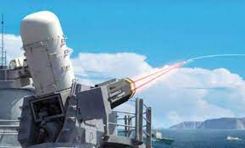
Downsides/Cons
They would use a lot of power to operate
Lasers shot by laser guns can be deflected
Lasers can be affected by atmospheric conditions, such as fog, smoke, or dust.

Slide 8
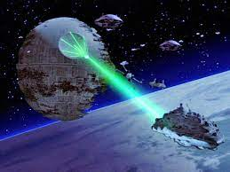
Downsides/Cons
Hard to develop & Deploy
Weight and size barriers
Specialized job

Slide 9
Summary
We are neither approve or disapprove of the laser gun and it making advancements in today's world. It would help protect our country in war by being more precise and shooting down missiles.

Slide 10
References
Science & Tech Spotlight
The Promise and Problems of Laser Weapons
High-Energy Laser Weapons

